Slide 1
CSC1004 Tutorial 4 Shihao Hong

Slide 2
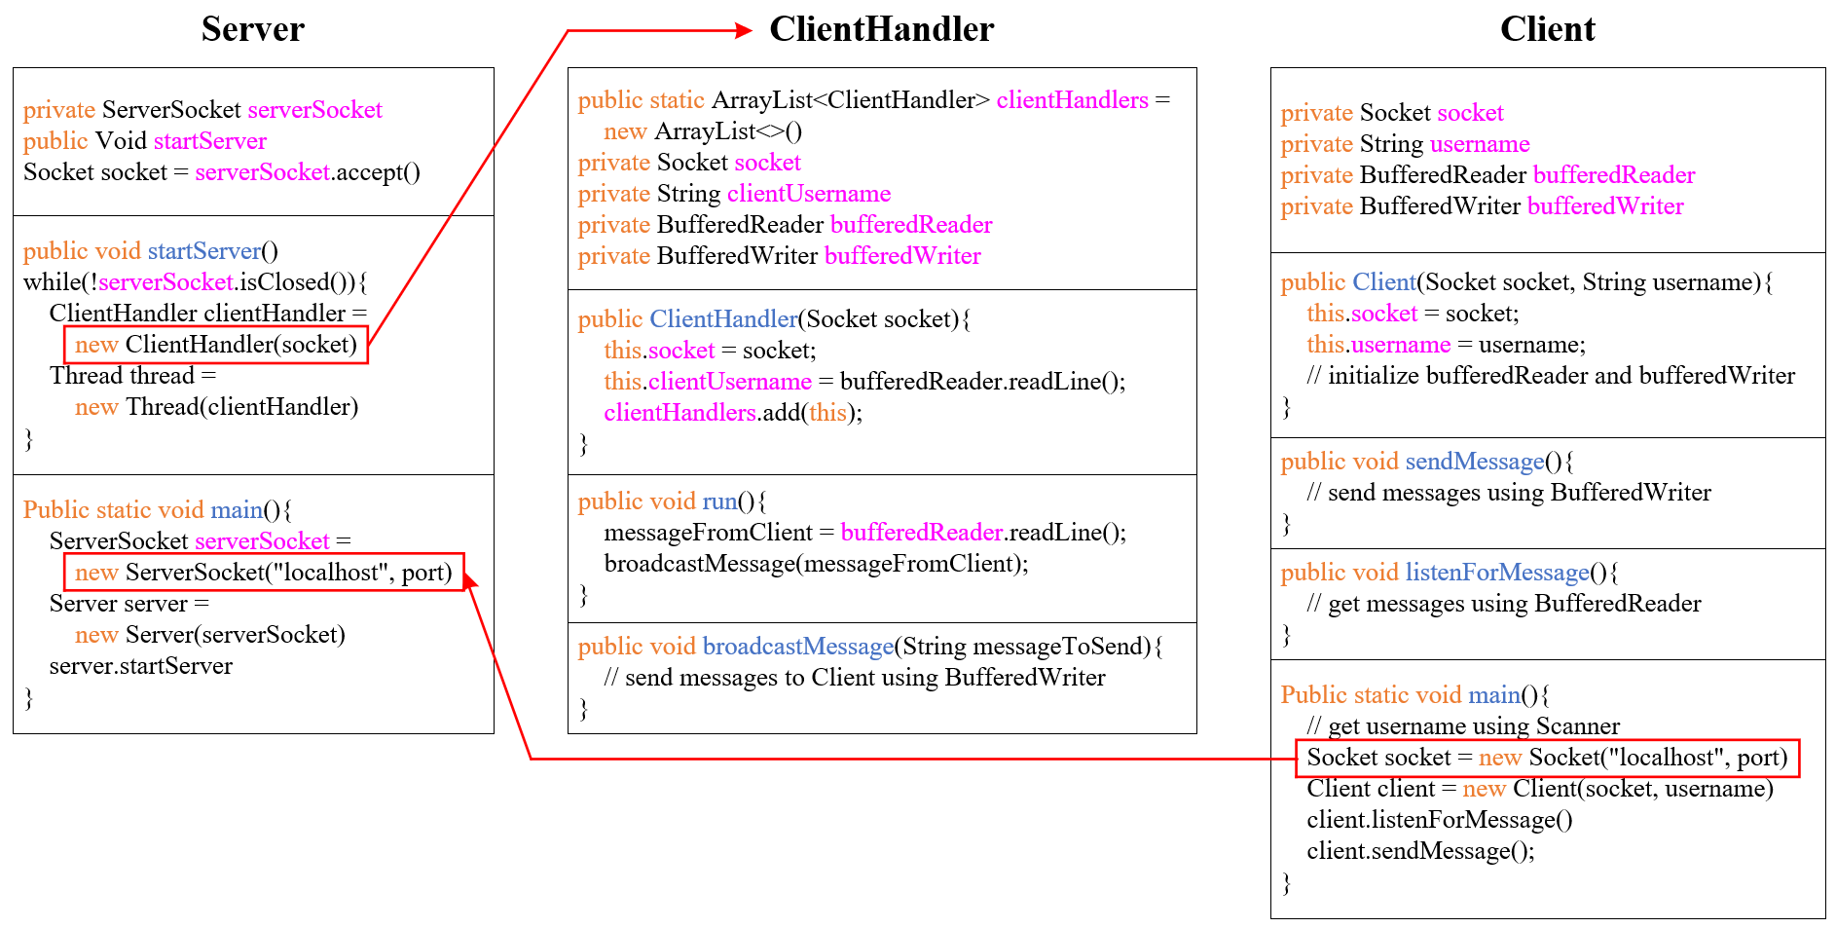
Framework of Project #1

Slide 3
Structure of Project: Client
Class Client
Sub-Thread
Main Process
Set up the Socket.
Initialize the reader and the writer.
Record the username.
Constructors()
listenForMessage()
Create a new thread.
Listen for the message send from the sever.
Send username to the sever.
Create a while loop until the socket connection ends.
Inside the while loop
Read the msg from keyboard and send it to sever.
sendMessage()
while(socket.
isConnected())

Slide 4
Structure of Project: Server
Set up the ServerSocket.
Create a while loop to
Accept new connection requestion from client.
Construct a ClientHandler for each connected client.
Put the ClientHandler into a thread and start the thread
Class Server
Main Process
startServer()
Socket socket =
serverSocket.accept();
while(!serverSocket.isClosed())
Sub-Thread
Sub-Thread
Sub-Thread
ClientHandler(socket)
ClientHandler(socket)
ClientHandler(socket)

Slide 5
Structure of Project: ClientHandler
Class ClientHandler
implements Runnable
Initialize the reader and the writer.
Add this ClientHandler to the public ArrayList<ClientHandler> clientHandlers.
Broadcast the Message to all connected client
Constructors()
Inside the while loop:
Read Message from the client that is being handled.
Broadcast the Message to all connected client with broadcastMessage().
run()
while(socket.isConnected())
Create a for loop to scan over all the created ClientHandlers recorded in the public ArrayList<ClientHandler> clientHandlers.
For each ClientHandlers, use its writer the write the message to its client.
broadcastMessage()

Slide 6
Java Multithreading
Java is a multi-threaded programming language which means we can develop multi-threaded program using Java. A multi-threaded program contains two or more parts that can run concurrently and each part can handle a different task at the same time making optimal use of the available resources specially when your computer has multiple CPUs.
By definition, multitasking is when multiple processes share common processing resources such as a CPU. Multi-threading extends the idea of multitasking into applications where you can subdivide specific operations within a single application into individual threads. Each of the threads can run in parallel. The OS divides processing time not only among different applications, but also among each thread within an application.
Multi-threading enables you to write in a way where multiple activities can proceed concurrently in the same program.

Slide 7
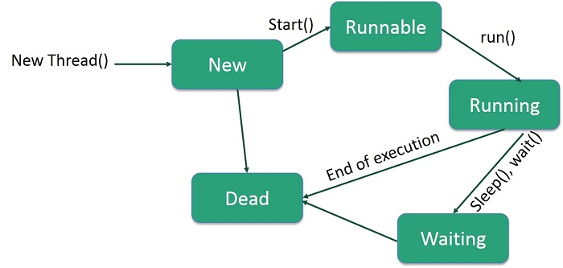
Life Cycle of a Thread

Slide 8
Life Cycle of a Thread
New − A new thread begins its life cycle in the new state. It remains in this state until the program starts the thread. It is also referred to as a born thread.
Runnable − After a newly born thread is started, the thread becomes runnable. A thread in this state is considered to be executing its task.
Waiting − Sometimes, a thread transitions to the waiting state while the thread waits for another thread to perform a task. A thread transitions back to the runnable state only when another thread signals the waiting thread to continue executing.
Timed Waiting − A runnable thread can enter the timed waiting state for a specified interval of time. A thread in this state transitions back to the runnable state when that time interval expires or when the event it is waiting for occurs.
Terminated (Dead) − A runnable thread enters the terminated state when it completes its task or otherwise terminates.

Slide 9
Java Multithreading
Advantages of Java Multithreading
1) It doesn't block the user because threads are independent and you can perform multiple operations at the same time.
2) You can perform many operations together, so it saves time.
3) Threads are independent, so it doesn't affect other threads if an exception occurs in a single thread.
Threads can be created by using two mechanisms :
Extending the Thread class
Implementing the Runnable Interface
Java provides Thread class to achieve thread programming. Thread class provides constructors and methods to create and perform operations on a thread. Thread class extends Object class and implements Runnable interface.

Slide 10
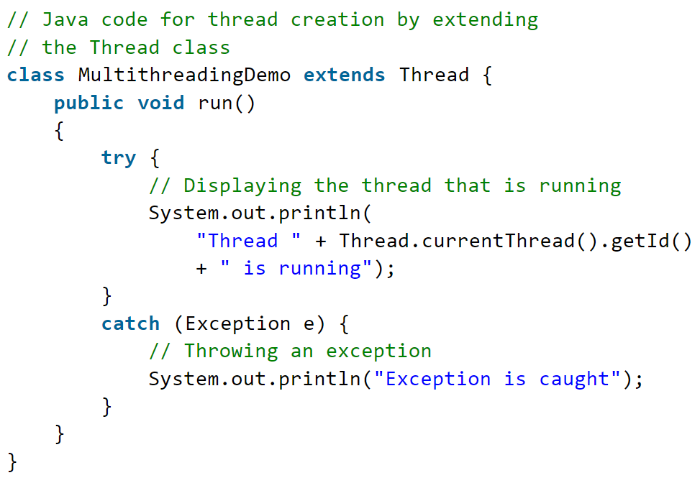
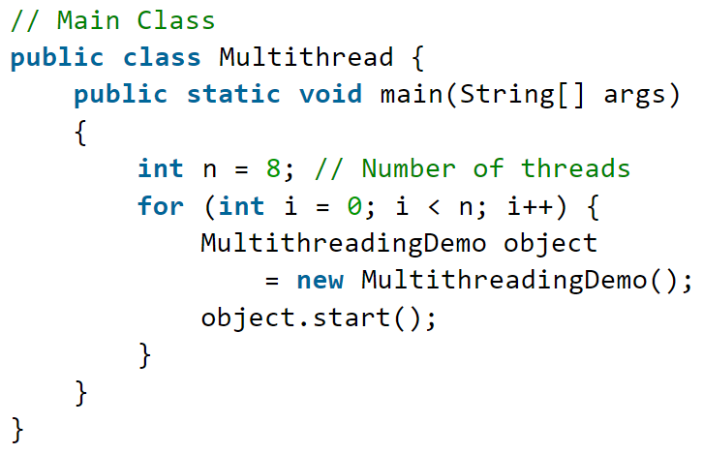
Thread Class Example

Slide 11
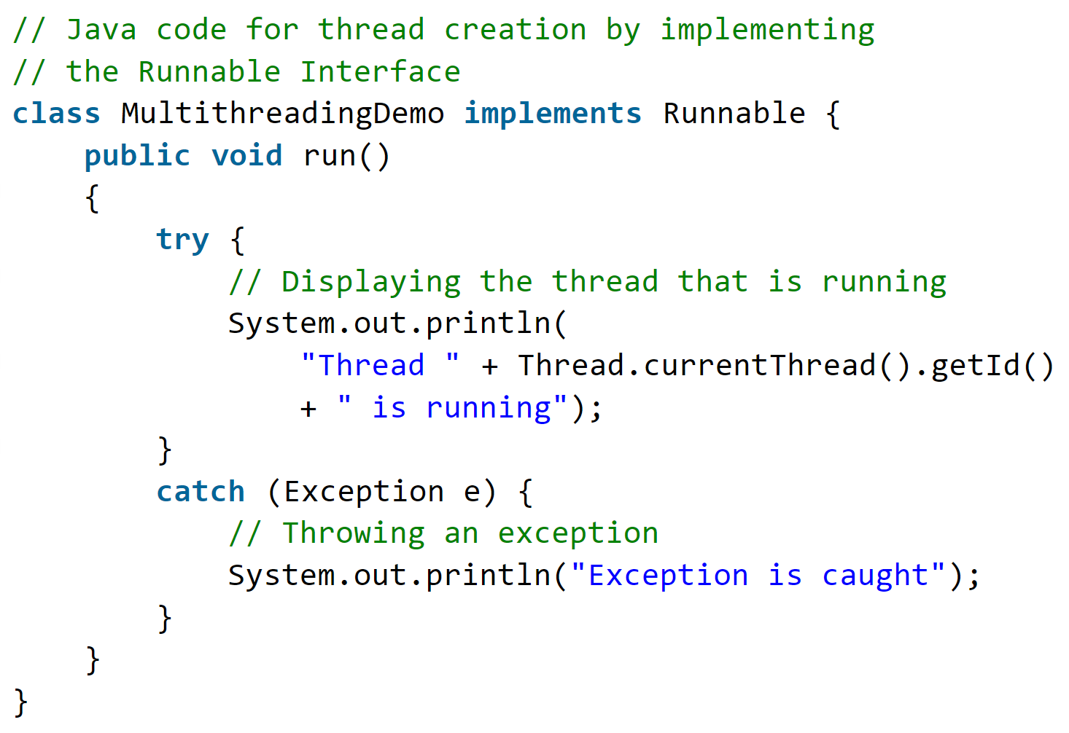
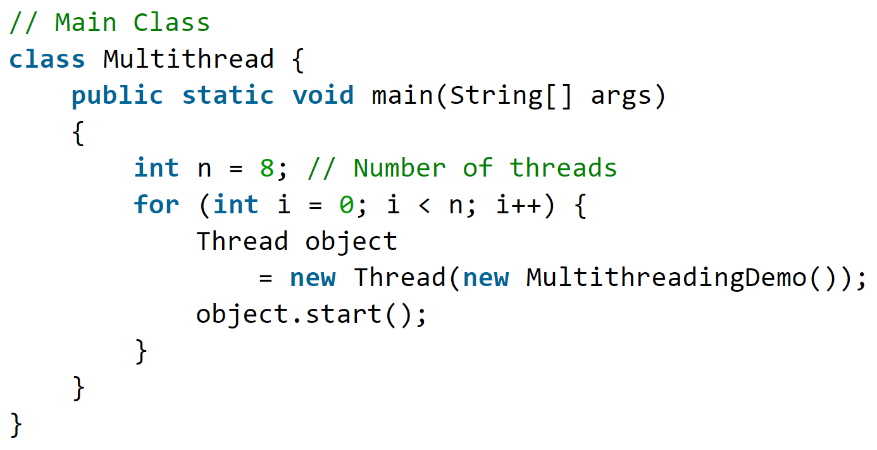
Thread by Runnable Interface
We can also create a new class which implements java.lang.Runnable interface and override run() method. Then we instantiate a Thread object and call start() method on this object.

Slide 12
Multithreading in Project #1
public class Server{
private ServerSocket serverSocket; // See previous slides, serverSocket is used to implement the server
public Server(ServerSocket serverSocket) {
this.serverSocket = serverSocket; // “this.serverSocket” refers to the private “serverSocket” in this class
}
public void startServer(){
while(!serverSocket.isClosed()){
Socket socket = serverSocket.accept(); // See previous slides, returns the socket and establish a connection between server and client
// Codes needed here to handle the clients with Multithreading techniques
ClientHandler clientHandler = new ClientHandler(socket);
Thread thread = new Thread(clientHandler);
thread.start();
}
}
// Note that other functions, e.g., closing the server, are required
public static void main(String[] args) throws IOException { // the “main” function}
}

Slide 13
Multithreading in Project #1
public class Client{
private Socket socket; // See previous slides, socket is used to implement the client
private BufferedReader bufferedReader; // Read from the server
private BufferedWriter bufferedWriter; // Write to the terminal
private String username;
public Client(Socket socket, String username){// See previous slides}
public void sendMessage(){// Functions leveraging bufferedWriter}
public void listenForMessage(){
new Thread(new Runnable(){
@Override
public void run(){
String msgFromGroupChat;
while(socket.isConnected()){
msgFromGroupChat = bufferedReader.readLine();
System.out.println(msgFromGroupChat);}
}
}).start();}
// Note that other functions, e.g., closing the client, are required
public static void main(String[] args) throws IOException {// the “main” function}

Slide 14
Multithreading in Project #1
public class ClientHandler implements Runnable{
private Socket socket;
private BufferedReader bufferedReader;
private String clientUsername;
public ClientHandler(Socket socket){
this.socket = socket;
this.bufferedReader = new BufferedReader(new InputStreamReader(socket.getInputStream()));
this.clientUsername = bufferedReader.readLine();
clientHandlers.add(this);
broadcastMessage();}
@Override
public void run() {
String messageFromClient;
while(socket.isConnected()){
messageFromClient = bufferedReader.readLine();
broadcastMessage(messageFromClient);}}
// Note that other functions, e.g., removing the client, are required
public void broadcastMessage(String messageToSend){// Send messages to other clients}
}

Slide 15

THANK YOU
林天麟 教授
香港中文大学（深圳）
机器人与人工智能实验室
WeChat: tinlunlam

